Slide 1
Unemployment Rate and Natural Rate of Unemployment rate (2018-2020)
 | U-Rate | Natura Rate
2018-01-01 | 4.1 | 4.597
2018-02-01 | 4.1
2018-03-01 | 4.0
2018-04-01 | 4.0 | 4.592
2018-05-01 | 3.8
2018-06-01 | 4.0
2018-07-01 | 3.8 | 4.587
2018-08-01 | 3.8
2018-09-01 | 3.7
2018-10-01 | 3.8 | 4.582
2018-11-01 | 3.7
2018-12-01 | 3.9
2019-01-01 | 4.0 | 4.577
2019-02-01 | 3.8
2019-03-01 | 3.8
2019-04-01 | 3.6 | 4.572
2019-05-01 | 3.6
2019-06-01 | 3.7
2019-07-01 | 3.7 | 4.567
2019-08-01 | 3.7
2019-09-01 | 3.5
2019-10-01 | 3.6 | 4.562
2019-11-01 | 3.5
2019-12-01 | 3.5
2020-01-01 | 3.6 | 4.558
https://www.bls.gov/cps/ (BLS, 02/07/2020)

Slide 2
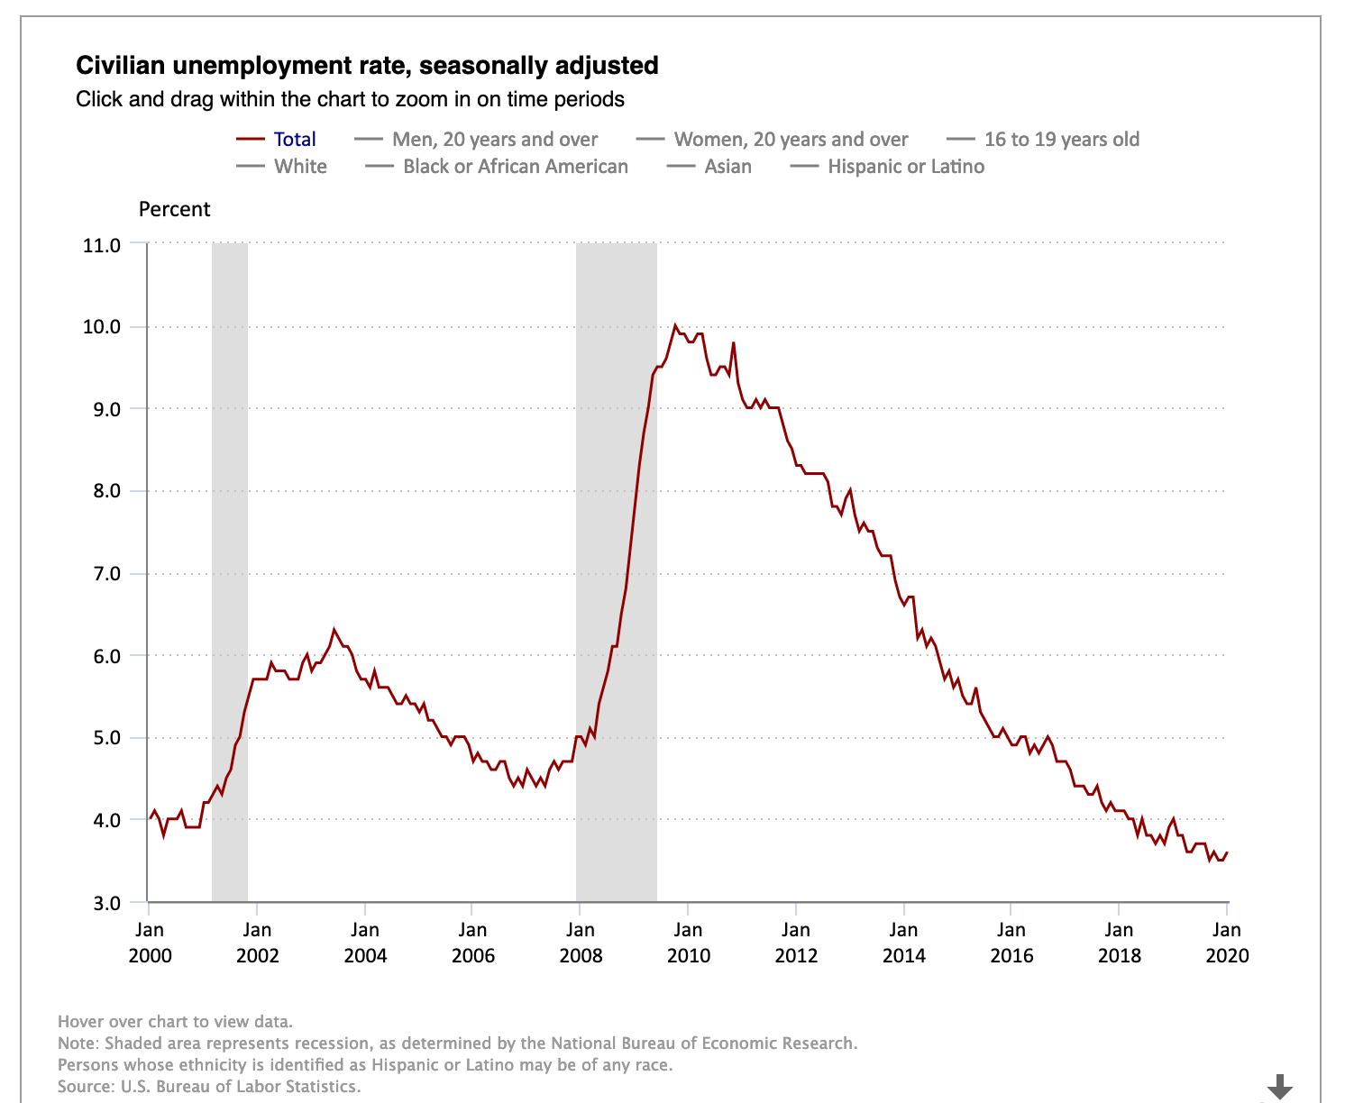

Slide 3
Ch. 29
The Monetary System

Slide 4
Look for the answers to these questions:
What assets are considered “money”? What are the functions of money? The types of money?
What is the Federal Reserve?
What role do banks play in the monetary system? How do banks “create money”?
How does the Federal Reserve control the money supply?

Slide 5
What Money Is and Why It’s Important
Without money
Trade would require barter: the exchange of one good or service for another.
Requires a double coincidence of wants: unlikely occurrence that two people each have a good the other wants.
Waste of resources: people spend time searching for others to trade with
Using money
Solves those problems
Notes:
“Double coincidence of wants” simply means that two people have to want each other’s stuff.

Slide 6
The 2 Kinds of Money
Commodity money:
Takes the form of a commodity with intrinsic value
Examples: gold coins, cigarettes
Fiat money:
Money without intrinsic value, used as money because of government decree
Example: the U.S. dollar
Notes:
Intrinsic value means the commodity would have value even if it weren’t being used as money.
Fiat money is worthless—except as money. Yet, people are happy to accept your dollars (or euros or yen or whatever) because they know they will be able to spend the currency.

Slide 7
The Meaning of Money
Money
Set of assets in an economy
That people regularly use
To buy goods and services from other people
Liquidity
Ease with which an asset can be converted into the economy’s medium of exchange

Slide 8
The 3 Functions of Money
Medium of exchange
Item that buyers give to sellers when they want to purchase goods and services
Unit of account
Yardstick people use to post prices and record debts
Store of value
Item that people can use to transfer purchasing power from the present to the future
Notes:
Money is a medium of exchange. That just means you use money to buy stuff.
Money is a unit of account. The price or monetary value of virtually everything is measured in the same units—dollars (in the U.S., or substitute your country’s currency if you’re located outside the U.S.). Imagine how hard it would be to plan your budget or comparison shop if sellers each used their own system of measuring prices.
Money is a store of value. Money holds its value over time, so you don’t have to spend it immediately upon receiving it.

Slide 9
Money in the U.S. Economy
Money stock (or Money Supply)
Quantity of money circulating in the economy

Slide 10
Money in the U.S. Economy
Measures of money stock
M1
Currency
Demand deposits, Traveler’s checks
Other checkable deposits
M2
Everything in M1
Savings deposits, Small time deposits
Money market mutual funds
A few minor categories

Slide 11
M1
Currency:
Paper bills and coins in the hands of the (non-bank) public
Demand deposits:
Balances in bank accounts that depositors can access on demand by writing a check

Slide 12
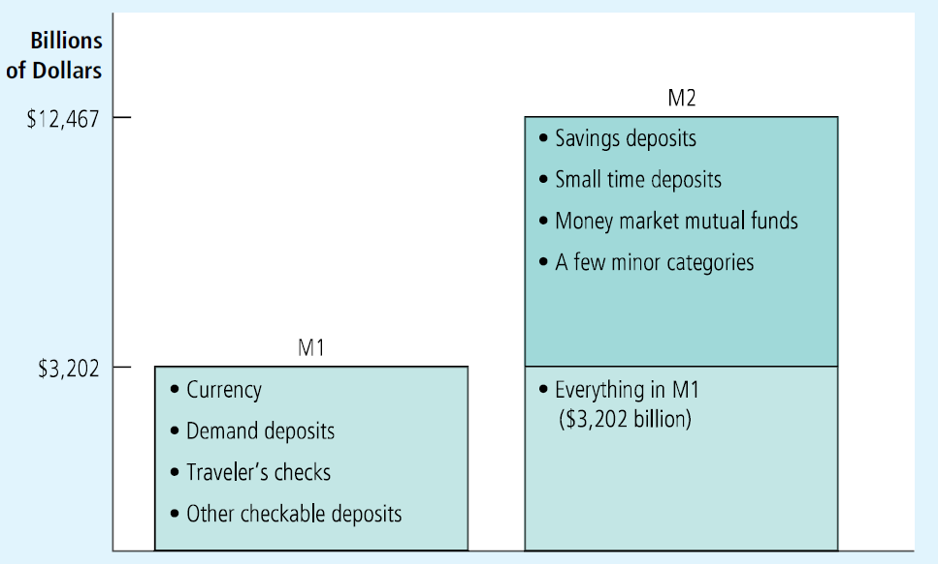
Two Measures of the Money Stock for the U.S. Economy
The two most widely followed measures of the money stock are M1 and M2. This figure shows the size of each measure in January 2016.

Slide 13
Are Credit Card Money?

Slide 14
The Federal Reserve System
Central bank
Institution designed to
Oversee the banking system
Regulate the quantity of money in the economy
The Federal Reserve (the Fed)
The central bank of the United States
Created in 1913 after a series of bank failures in 1907
Purpose: to ensure the health of the nation’s banking system

Slide 15
The Fed’s Organization, Part 3
The Fed’s jobs
Regulate banks and ensure the health of the banking system
Regional Federal Reserve Banks
Monitors each bank’s financial condition
Facilitates bank transactions - clearing checks
Acts as a bank’s bank
The Fed – lender of last resort

Slide 16
The Structure of the Fed
The Federal Reserve System consists of:
Board of Governors
(7 members), located in Washington, DC
12 regional Fed banks
Located around the U.S.
Federal Open Market Committee (FOMC),
includes the Board of Governors (7 members) and 5 presidents of the regional Fed banks.
The FOMC decides monetary policy.

Slide 17
The Fed’s Organization
Board of governors
7 members, 14-year terms
Appointed by the president and confirmed by the Senate
The chairman: Jerome Powell
Directs the Fed staff
Presides over board meetings
Testifies regularly about Fed policy in front of congressional committees.
Appointed by the president (4-year term)

Slide 18
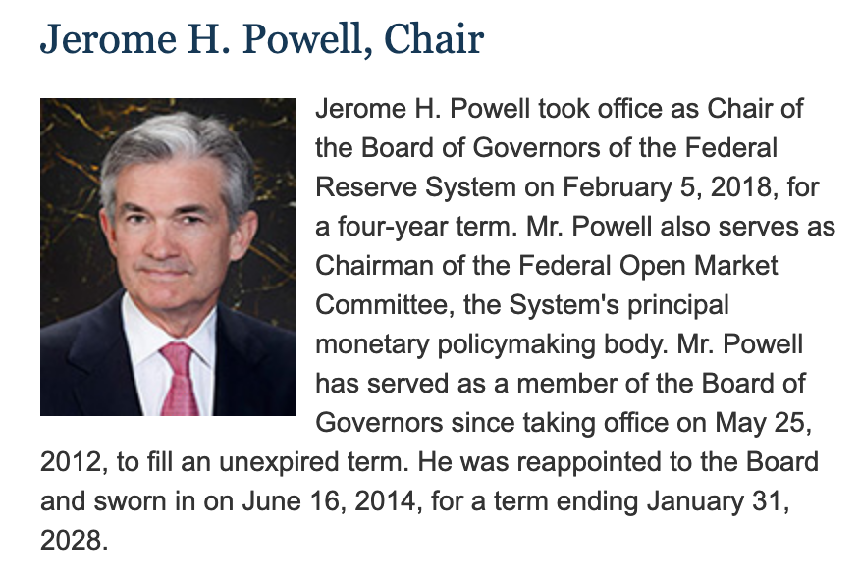
https://www.federalreserve.gov/aboutthefed/bios/board/powell.htm

Slide 19
The Fed’s Organization
12 regional Federal Reserve Banks
Major cities around the country
The presidents are chosen by each bank’s board of directors

Slide 20
Location of the 12 Regional Fed Reserve

Slide 21
The Structure of the Federal Reserve System

Slide 22
Federal Open Market Committee, Part 1
FOMC
7 members of the board of governors
5 of the twelve regional bank presidents
All twelve regional presidents attend each FOMC meeting, but only five get to vote
Meets about every 6 weeks in Washington, D.C.
Discuss the condition of the economy
Consider changes in monetary policy

Slide 23
The Fed’s Organization
The Fed’s jobs
Control the money supply
Quantity of money available in the economy
Monetary policy: by the Federal Open Market Committee (FOMC)
Money supply
Quantity of money available in economy
Monetary policy
Setting of the money supply

Slide 24

Banks and the Money Supply
Money
Currency + Demand deposits
Behavior of banks
Can influence the quantity of demand deposits in the economy (and the money supply)
“I’ve heard a lot about money, and now I’d like to try some.”

Slide 25
Bank Reserves
In a fractional reserve banking system
Banks keep a fraction of deposits as reserves and use the rest to make loans.
The Fed establishes reserve requirements
Regulations on the minimum amount of reserves that banks must hold against deposits.
Banks may hold more than this minimum
The reserve ratio, R
=fraction of deposits that banks hold as reserves
=total reserves as a percentage of total deposits

Slide 26
Bank T-Account
T-account: a simplified accounting statement that shows a bank’s assets & liabilities.
Banks’ liabilities include deposits,
Assets include loans & reserves.
Notice that R = $10/$100 = 10%.
FIRST NATIONAL BANK
Assets | Liabilities
Reserves $ 10 Loans $ 90 | Deposits $100

Slide 27
Banks and the Money Supply: An Example
Suppose $100 of currency is in circulation.
To determine banks’ impact on money supply (quantity of money available in economy), we calculate the money supply in 3 different cases:
No banking system
100% reserve banking system (banks hold 100% of deposits as reserves, make no loans)
Fractional reserve banking system

Slide 28
Banks and the Money Supply: An Example
Case 1: No banking system
Money supply = $100.
Public holds the $100 as currency.

Slide 29
Banks and the Money Supply: An Example
Case 2: 100% reserve banking system
Public deposits the $100 at First National Bank (FNB).
FNB holds 100% of deposit as reserves:
Money supply = currency + deposits = $0 + $100 = $100
In a 100% reserve banking system, banks do not affect size of money supply.
FIRST NATIONAL BANK
Assets | Liabilities
Reserves $100 Loans $ 0 | Deposits $100

Slide 30
Banks and the Money Supply: An Example
Case 3: Fractional reserve banking system
Suppose R = 10%. FNB loans all but 10% of the deposit:
FIRST NATIONAL BANK
Assets | Liabilities
Reserves $100 Loans $ 0 | Deposits $100
FIRST NATIONAL BANK
Assets | Liabilities
Reserves $10 Loans $90 | Deposits $100
Depositors have $100 in deposits, borrowers have $90 in currency.
Money supply = C + D = $90 + $100 = $190 (!!!)
Notes:
The notion that banks create money by making loans is a new and perhaps awkward idea for students. The following slide may help.

Slide 31
Banks and the Money Supply: An Example
Case 3: Fractional reserve banking system
How did the money supply suddenly grow?
When banks make loans, they create money.
The borrower gets
$90 in currency—an asset counted in the money supply
$90 in new debt—a liability that does not have an offsetting effect on the money supply
A fractional reserve banking system creates money, but not wealth.
Notes:
Students more easily accept the idea that banks create money when they see that banks do not create wealth.

Slide 32
Banks and the Money Supply: An Example
Case 3: Fractional reserve banking system
Borrower deposits the $90 at Second National Bank.
Initially,
SNB’s T-account
looks like this:
SECOND NATIONAL BANK
Assets | Liabilities
Reserves $90 Loans $ 0 | Deposits $90
SECOND NATIONAL BANK
Assets | Liabilities
Reserves $ 9 Loans $81 | Deposits $90
If R = 10% for SNB, it will loan all but 10% of the deposit.

Slide 33
Banks and the Money Supply: An Example
Case 3: Fractional reserve banking system
SNB’s borrower deposits the $81 at Third National Bank.
Initially,
TNB’s T-account
looks like this:
THIRD NATIONAL BANK
Assets | Liabilities
Reserves $81 Loans $ 0 | Deposits $81
THIRD NATIONAL BANK
Assets | Liabilities
Reserves $ 8.10 Loans $72.90 | Deposits $81
If R = 10% for TNB, it will loan all but 10% of the deposit.

Slide 34
Banks and the Money Supply: An Example
Case 3: Fractional reserve banking system
The process continues, and money is created with each new loan.
Original deposit = $100.00
FNB lending = $ 90.00
SNB lending = $ 81.00
TNB lending = $ 72.90
… …
Total money supply = $1,000.00
In this example, $100 of reserves generates $1,000 of money.

Slide 35
The Money Multiplier
Money multiplier = 1/R
Amount of money the banking system generates with each dollar of reserves
In our example, R = 10%
Money multiplier = 1/R = 1/0.10=10
$100 of reserves creates $1,000 of money
$100 x 10 = $1,000

Slide 36
The Money Multiplier
Money multiplier = 1/R
Amount of money the banking system generates with each dollar of reserves
The higher the reserve ratio, the smaller the money multiplier.
→ A decrease in money supply

Slide 37
Fed’s Tools of Monetary Control, Part 1
Influences the quantity of reserves
Open-market operations
Fed lending to banks
Influences the reserve ratio
Reserve requirements
Paying interest on reserves

Slide 38
Fed’s Tools of Monetary Control, Part 2
A) Open-market operations
Purchase and sale of U.S. government bonds by the Fed
To increase the money supply
The Fed buys U.S. government bonds
To reduce the money supply
The Fed sells U.S. government bonds
Easy to conduct
Used more often

Slide 39
Fed’s Tools of Monetary Control, Part 3
B) Fed lending to banks
Banks borrow from the Fed when they feel they don’t have enough reserve on hand.
To increase the money supply
How banks can borrow:
(1) Borrow from the Fed’s discount window and pay an interest rate on that loan (discount rate)
Additional reserve create more money.

Slide 40
Fed’s Tools of Monetary Control, Part 4
--Changing the discount rate
(Interest rate on the loans that the Fed makes to banks)
Higher discount rate
Reduce the money supply
Smaller discount rate
Increase the money supply

Slide 41
Fed’s Tools of Monetary Control, Part 5
(2) Term Auction Facility (2007 to 2010)
The Fed sets a quantity of funds it wants to lend to banks
Eligible banks bid to borrow those funds
Loans go to the highest eligible bidders
Acceptable collateral
Pay the highest interest rate

Slide 42
Fed’s Tools of Monetary Control, Part 6
C) Reserve requirements
Minimum amount of reserves that banks must hold against deposits
An increase in reserve requirement: decrease the money supply
A decrease in reserve requirement: increase the money supply
Used rarely – disrupt business of banking
Less effective in recent years
Many banks hold excess reserves

Slide 43
Fed’s Tools of Monetary Control, Part 7
D) Paying interest on reserves
Traditionally, banks did not earn any interest on the reserve they hold. However the Fed began paying interest on reserves.
Since October 2008
The higher the interest rate on reserves
The more reserves banks will choose to hold
An increase in the interest rate on reserves
Increase the reserve ratio
Lower the money multiplier
Lower the money supply

Slide 44
Problems in Controlling the Money Supply
The Fed’s control of the money supply
Not precise
The Fed does not control:
The amount of money that households choose to hold as deposits in banks
The amount that bankers choose to lend

Slide 45
The Federal Funds Rate, Part 1
The discount rate
Interest rate on the loans that the Fed makes to banks
The federal funds rate
Interest rate at which banks make overnight loans to one another bank
Lender – has excess reserves
Borrower – needs reserves
A change in federal funds rate
Changes other interest rates

Slide 46
The Federal Funds Rate, Part 2
The federal funds rate
Differs from the discount rate
Affects other interest rates as well
Is determined by supply and demand in the market for loans among banks
Targeted by the Fed
Change the federal funds rate
Change the money supply

Slide 47
The Federal Funds Rate, Part 3
The Fed targets the federal funds rate through open-market operations
The Fed buys bonds
Decrease in the federal funds rate
Increase in money supply
The Fed sells bonds
Increase in the federal funds rate
Decrease in money supply

Slide 48
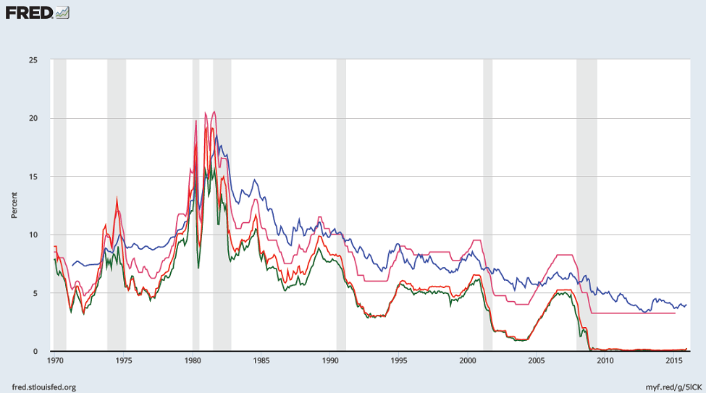
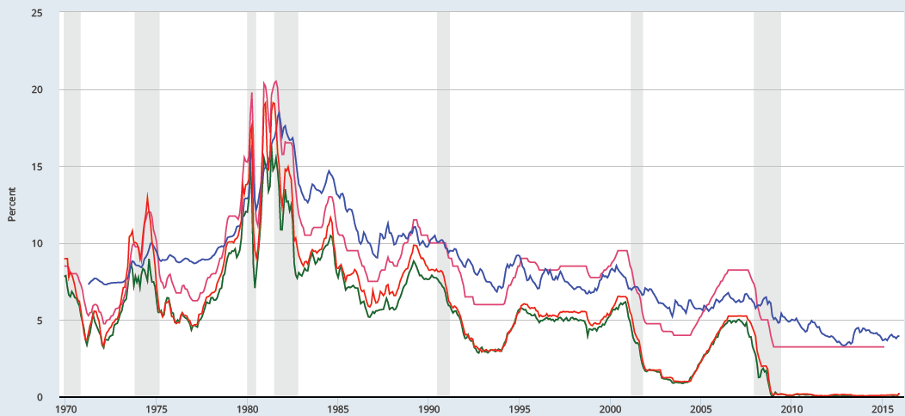
The Fed Funds rate and other rates, 1970–2016
Fed. Funds
Mortgage
Prime
3 Month T-bill
Notes:
The prime rate (the rate banks charge on loans to their best customers; IRSTPI01USM156N) and the 3-month Treasury Bill rate (TB3MS) are very highly correlated with the Fed Funds rate.
The mortgage rate shown is the 30-year fixed rate (MORTGAGE30US). It is less correlated with the Federal Funds rate (DFF), but this is to be expected: Fed Funds are overnight loans between banks, while mortgages are 30-year loans to consumers.
source: FRED database
http://research.stlouisfed.org/fred2/
Image permalink: https://fred.stlouisfed.org/graph/fredgraph.png?g=5lC5

Slide 49
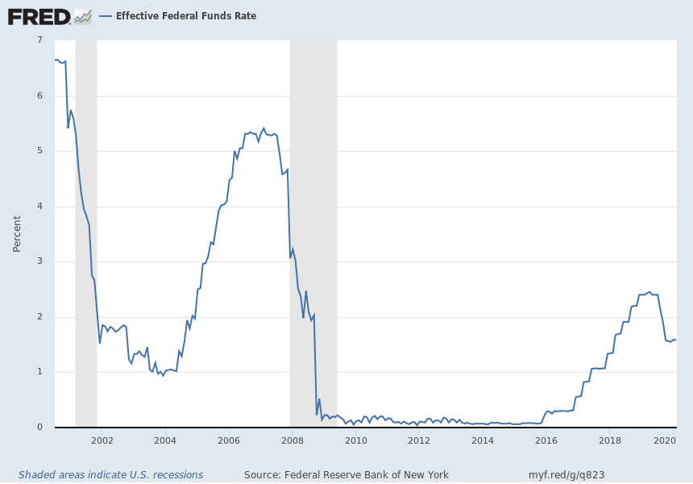
Effective Federal Funds Rate (2000-2020)
https://fred.stlouisfed.org/series/EFFR#0
Notes:
Source: Federal Reserve Bank of New York Release: Federal Funds Data Units: Percent, Not Seasonally Adjusted Frequency: Daily The federal funds market consists of domestic unsecured borrowings in U.S. dollars by depository institutions from other depository institutions and certain other entities, primarily government-sponsored enterprises.The effective federal funds rate (EFFR) is calculated as a volume-weighted median of overnight federal funds transactions reported in the FR 2420 Report of Selected Money Market Rates.For more information, visit the Federal Reserve Bank of New York. Federal Reserve Bank of New York, Effective Federal Funds Rate [EFFR], retrieved from FRED, Federal Reserve Bank of St. Louis; https://fred.stlouisfed.org/series/EFFR, February 10, 2020.

Slide 50
https://www.federalreserve.gov/monetarypolicy/files/monetary20200129a1.pdf
https://www.federalreserve.gov/monetarypolicy/fomc.htm

Slide 51
Summary
Money serves three functions: medium of exchange, unit of account, and store of value.
There are two types of money: commodity money has intrinsic value; fiat money does not.
The U.S. uses fiat money, which includes currency and various types of bank deposits.

Slide 52
Summary
In a fractional reserve banking system, banks create money when they make loans.
Bank reserves have a multiplier effect on the money supply.
Because banks are highly leveraged, a small change in the value of a bank’s assets causes a large change in bank capital.
To protect depositors from bank insolvency, regulators impose minimum capital requirements.

Slide 53
Summary
The Federal Reserve is the central bank of the U.S. The Fed is responsible for regulating the monetary system.
The Fed controls the money supply mainly through open-market operations.
Purchasing government bonds increases the money supply, selling government bonds decreases it.
In recent years, the Fed has set monetary policy by choosing a target for the federal funds rate.

